Slide 1

Department of Information Technology NBA Accredited
A.P. Shah Institute of Technology G.B.Road,Kasarvadavli, Thane(W), Mumbai-400615
UNIVERSITY OF MUMBAI
Academic Year 2021-2022

Slide 2
A Project Report on
Pharma Supply Chain Monitroing System using Iot & Blockchain
Submitted in partial fulfillment of the degree of Bachelor of Engineering(Sem-8) in
INFORMATION TECHNOLOGY
By
Yash Bhosale(18104049)
Jainam Chopra(18104064) Satish Gupta (18104024)
Under the Guidance of Prof. Apeksha Mohite
Under the Guidance of Prof. Nahidkausar Shaikh

Slide 3
1.Project Conception and Initiation

Slide 4
1.1 Abstract
News of the effectively completed vaccine trials have the ability to hold consolation to billions of human beings throughout the world. But as encouraging as the ones trials also can moreover be, it`s miles incredibly vital to observe that a vaccine can not be as effective if it is not efficaciously allotted and trusted thru manner of approach of the public. As 77% of U.S. citizens are concerned about the safety and efficacy of vaccines, a whole-of-government technique is critical thru the very last mile to infuse speed, accountability, and transparency during the vaccine distribution system.
There is a pressing need for product tracking and tracing on account of globalized supply chains, several suppliers, risk of counterfeit products, and customer name for for in-depth visibility. Effective vaccine Cold Chain Logistics (CCL) manipulate may be required for precise coordination and cooperation during multiple activities to make certain the right situation of vaccines, which require temperature tracking, distribution of records for traceability.

Slide 5
1.1 Abstract
Our Method describe the shape required to mix IoT and Blockchain into the deliver chain manipulate Web platform to show the temperature of insulated discipline or cooler box. In this study, it shows that promising system of integrating IoT and Blockchain for COVID-19 vaccine deliver chain control manipulate.

Slide 6
1.2 Objectives
To make the process transparent and free from human errors, which traditionally were present in the existing infrastructure.
• To get a near real time update of the whereabouts of a shipment.
• To create trust between new parties due to the use of immutable transactions present in the blockchain, which proves the trustworthiness.
• To build a simple user interface for a common customer to use it.
• To design a supply chain traceability system that models manufacturing processes as token recipes.
• To present a prototypical implementation for the Ethereum Virtual Machine (EVM) using smart contracts.
• To make users or the members present in a blockchain aware about the whereabouts’ and the conditions of vaccines, medicine’s etc.
• To provide a decentralized, immutable, and secure blockchain.

Slide 7
1.3 Literature Review
● Title: Product Tracking and Tracing with IOT and Blockchain, Infosys
2020 5th International conference
o Authors: Dr. Arnab Banarjee, Murali Venkatesh
Findings: Current supply chain monitoring is limited just to certain logistic
activities, real time condition monitoring of medicines, vaccines still a
problem. The proper use of IOT and Blockchain is made to sense
tamperproof data using TEE(Trusted execution environment), and tamper
proof software using cloud and blockchain which give impregnable
security in terms of data integrity which use SHA 256 algorithm the most
secure algorithm in terms of cryptography and hashing the input data it
cannot be breached. So, this combination of tamperproof hardware and
tamperproof software helps building tamperproof and transparent system.

Slide 8
2 o Title : Sustainable evaluation and verification in supply chains: aligning and leveraging accountability to stakeholders, J. Oper. Manag. 38 (2015) 1–13.
o Author: J. Gualandris, R.D. Klassen, S. Vachon, M. Kalchschmidt
Findings : Monitoring assets from the manufacturing level-monitoring
components exactly from the time they are produced till the time they
are delivered to end customer. Many a times the parts/components are
stored in such conditions which either damage the component or destroy
it resulting in degrading the performance of the final product. Hence
finding the root liable authority for any damage caused is a major
problem. Blockchain issues token recipes for every component involved in
making a product, which starts monitoring the condition right from the
production line where the parts/components are produced and kept to be
stored.

Slide 9
1.4 Problem Definition
Existing COVID-19 vaccine supply chain processes are fragmented, making it difficult to capture
and collate the data generated at every touchpoint while ensuring product authenticity and continuity
of cold chain. Without aggregated data, it becomes difficult to get visibility into assets and conditions
throughout the value chain, leading to the following challenges:
Maintaining process and transaction transparency across all parties
Ensuring product authenticity and secure transfer of vaccines without breaking cold chain
Tracking secure box in real time for temperature control and ownership
No real-time data availability for decision making
Lack of a seamless process for controlled vaccine delivery
No process for dispute settlement in case of violation

Slide 10
1.5 Scope
1. Our project can be used in pharma supply chain
2. Our project can be used in efficient management of vaccines.
3. Our project can be used in logistics management of medical pharmacy equipment’s including door to door delivery.
4. Our project can be used in manufacturing operations etc.

Slide 11
1.6 Technology stack
Hardware:
Arduino uno: approx. 300/- rupees
GSM/GPRS/Bluetooth 2g module : approx. 1900/- rupees
Push Button : 70/-rupees
Software:
Firebase
HTML,CSS & JAVA
Android studio, Xcode, Arduino IDE,Remix IDE
Solidity

Slide 12
1.7 Benefits for environment & Society
● Every year many people die due to use of counterfeit or expired/damaged drugs,with proper monitoring many lives can be saved.
● Most raw materials used in the manufacturing process can be monitored right from the start, so that these raw materials can be saved and even the cost of production can be reduced.
● When such huge data is stored and monitored in a supply chain app it can be used in big data analytics and can help in predicting future sales order.

Slide 13
2. Project Design

Slide 14
2.1 Proposed System
IoT sensors/devices capture data automatically, without human intervention. It helps determine and verify the source of component materials and their regulatory compliance. Sensors embedded in transported goods can monitor items and alert supply chain members to issues such as temperature deviations or product damage. At every stage of the supply chain data is captured with sufficient granularity to conduct root-cause analyses, determine liability in case of an incident, and gain any number or type of insight.
When IoT data feeds into a blockchain, the data can be shared within a peer-to-peer network, distributed ledger. Each member of a supply chain—including producers, suppliers,processors, distributors, and retailers—is a node in the blockchain network and can access all data within the blockchain at any time.

Slide 15
Smart contracts— self-executing scripts residing within the blockchain—integrate members and allow for proper, distributed, heavily automated workflows for information sharing. This provides a fully transparent, single source of truth about the provenance of materials, production history, and condition of items in transit changes of custody and ownership, and last-mile delivery information— all in real time.

Slide 16
2.2 Design(Flow Of Modules)
Flow of Web Application
Flow of Iot Device
Flow of Blockchain App & Iot Device

Slide 17
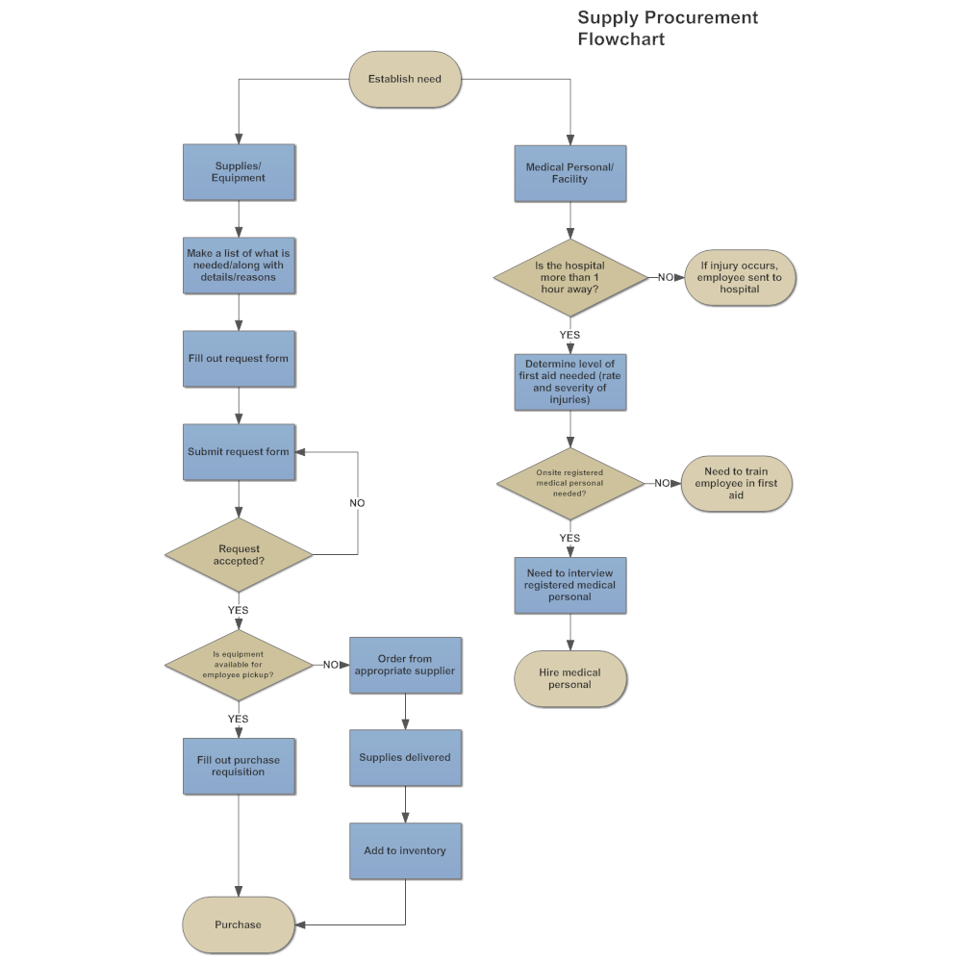
2.2 Design(Flow Of Modules)
Flow of supply chain Web Application

Slide 18
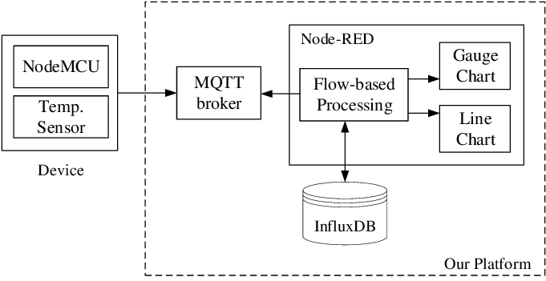
2.2 Design(Flow Of Modules)
Flow of Temperature monitoring Iot device

Slide 19
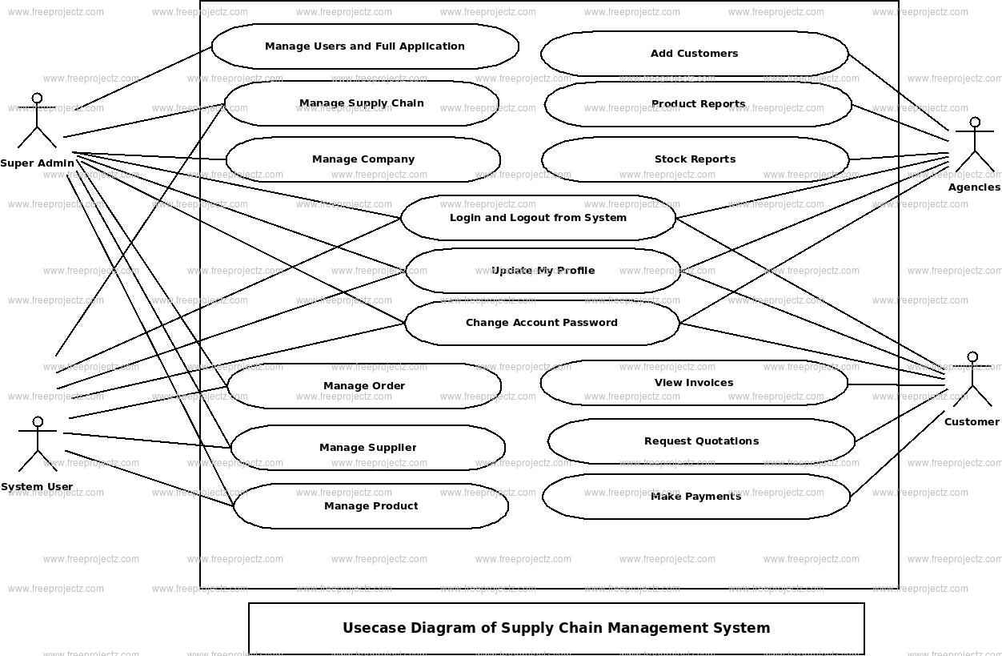
2.3 Use Case for Supply Chain Web App

Slide 20
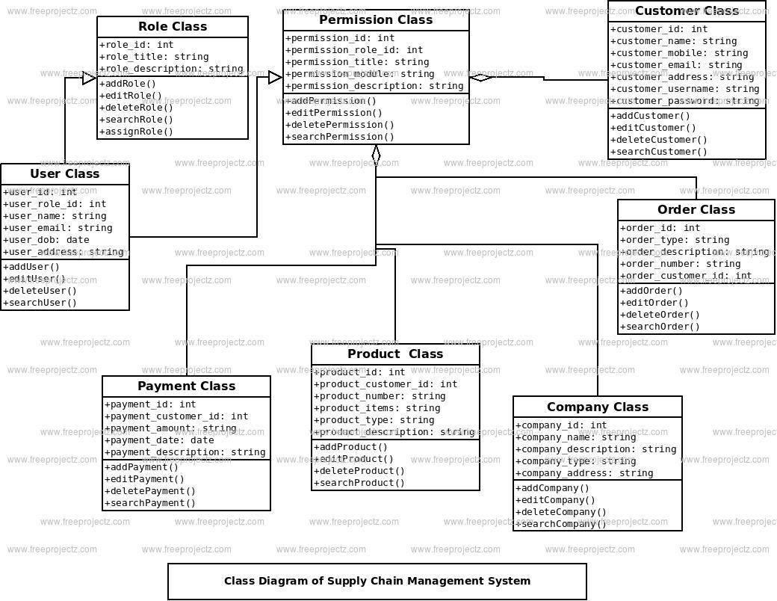
2.4 Class Diagram for Supply Chain Web App

Slide 21
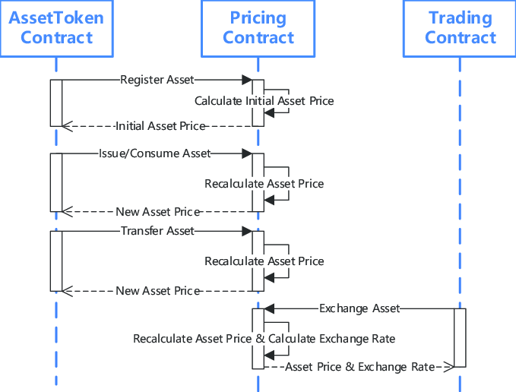
2.5 Sequence Diagram for Blockchain Smart Contracts

Slide 22
3. Implementation

Slide 23
4. Testing

Slide 24
Functional Testing
Unit Testing
Unit testing is the first level of testing and is often performed by the developers themselves. It is the process of ensuring individual components of a piece of software at the code level are functional and work as they were designed to. Developers in a test-driven environment will typically write and run the tests before the software or feature is passed over to the test team. Unit testing can be conducted manually. Unit testing will also make debugging easier because finding issues earlier means they take less time to fix than if they were discovered later in the testing process.
The Unit testing is best suited for our application development phase. In that phase, we started to code in units create different modules. And test each module separately, like the login page, register page, home page, contacts page, emergency screen, analysis page etc. All these pages are tested and debugged before going further integrating. And check whether we are getting the desired output from each module as for the objectives.

Slide 25
Functional Testing
Integration Testing
After each unit is thoroughly tested, it is integrated with other units to create modules or components that are designed to perform specific tasks or activities. These are then tested as group through integration testing to ensure whole segments of an application behave as expected (i.e, the interactions between units are seamless). These tests are often framed by user scenarios, such as logging into an application or opening files. Integrated tests can be conducted by either developers or independent testers and are usually comprised of a combination of automated functional and manual tests.
As we have discussed unit testing the next step is integration testing. All the units
which we have tested and debugged are now ready to integrate into a whole single module. The integration part is crucial as we need to know which unit must interact without error, calling them in a different class accessing the instance of that class all these can be cleared with help of the sequence diagram which was represented in Project Design. So accordingly, modules are integrated and checked whether they behave as for the objectives.

Slide 26
Non-Functional Testing
Compatibility Testing
Compatibility testing is used to gauge how an application or piece of software will work in different environments. It is used to check that your product is compatible with multiple operating systems, platforms, browsers, or resolution configurations. The goal is to ensure that your software’s functionality is consistently supported across any environment you expect your end-users to be using.
The framework we are using to develop our Web application is HTML,CSS&JAVA. It is an open-source framework for building beautiful, natively compiled, multi-platform web applications from a single codebase. We make sure that our application is compatible with all web browsers. The features we developed are perfectly run in multiple operating systems without an error. For this reason, compatibility testing is best suited for our project.

Slide 27
5. Result

Slide 28
6. Conclusion and Future Scope

Slide 29
We have proposed a blockchain-based supply chain management system that enables tracing and tracking goods, including their transformation in the production process using smart contracts. The system provides comprehensive provenance information by projecting product compositions onto the blockchain in the form of tokens. Hereby, shortcomings of current traceability systems regarding isolated data storage and the problem of lacking transformation information are tackled. Defining compositions for production and enforcing them by using smart contracts enable the documentation of consumed resources in the production process. Through this mechanism, products are traceable from production to retail and the process starts from resource exploitation. As a result, transparency is generated along the supply chain, providing comprehensible production information.

Slide 30
References
[1] Guojun Ji and Rong Guo (2009). "Research on the security of cold-chain logistics," 2009 6th International Conference on Service Systems and Service Management, pp. 757-761, doi: 10.1109/ICSSSM.2009.5174982.
[2] Y. Xv, X. Zhang, X. Qiu and X. Liang (2020). "Analysis of cold chain development based on ISM model under the situation of (COVID-19)," 2020 16th Dahe Fortune China Forum and Chinese High-educational Management Annual Academic Conference (DFHMC), pp. 254-257, doi: 10.1109/DFHMC52214.2020.00055.
[3] D. Zhang and T. Han (2020). "Analysis of risk control factors of medical cold chain logistics based on ISM model," 2020 Chinese Control And Decision Conference (CCDC), pp. 4222-4227, doi: 10.1109/CCDC49329.2020.9164042.

Slide 31
References
[4] Shih, Chih-Wen and Chih-Hsuan Wang (2015). "Integrating wireless sensor network with statistical quality contorl to develop a cold chain system in food industries," Computer Statndards & Interfaces: 62-78.
[5] Monteleone, Sergio and Mario Sampaio (2017). "A novel deployment of smart Cold Chain system using 2G-RFID-Sys temperature monitoring in medicine Cold Chain based on Internet of Things," 2017 IEEE International Conference on Service Operations and Logistics, Informatics, Basel, Switzerland: MDPI. 205-210.
[6] Ruan, Junhu and Yan Shi (2016). "Monitoring and assessing fruit freshness in IoT-based e-commerce delivery using scenario analysis and interval number approaches," Information Science: 557-570.

Slide 32
References
[7] Chandra, Abel Avitesh and Seong Ro Lee (2014). "A Method of WSN and Sensor Cloud System to Monitor Cold Chain Logistics as part of the IoT Technology," International Journal of Multimedia and Ubiquitous Engineering: 145-152.
[7] L. Ding, J. Wang and L. Li (2015). "Privacy-Preserving Temperature Query Protocol in Cold-Chain Logistics," 2015 7th International Conference on Intelligent Human-Machine Systems and Cybernetics, pp. 113-116, doi: 10.1109/IHMSC.2015.98.
[8] N. N. Ahamed, T. K. Thivakaran and P. Karthikeyan (2021). "Perishable Food Products Contains Safe in Cold Supply Chain Management Using Blockchain Technology," 2021 7th International Conference on Advanced Computing and Communication Systems (ICACCS), pp. 167-172, doi: 10.1109/ICACCS51430.2021.9442057.

Slide 33
References
[9] T. Bengiovanni et al. (2020). "Risk Management and Healthcare: IoT Technologies and Smart Monitoring System for a Good Cold Chain Management," 2020 5th International Conference on Smart and Sustainable Technologies (SpliTech), pp. 1-6, doi: 10.23919/SpliTech49282.2020.9243821.
[10] V. Voicu, D. Petreus and R. Etz (2020). "IoT Blockchain for Smart Sensor," 2020 43rd International Spring Seminar on Electronics Technology (ISSE), pp. 1-5, doi: 10.1109/ISSE49702.2020.9120915.
[11] Usama Salama, Lina Yao and Hye-young Paik (2018). "An Internet of Things Based Multi-Level Privacy-Preserving Access Control for Smart Living," Informatics (Basel), vol. 5, no. 23, doi:10.3390/informatics5020023.

Slide 34
Paper Publication

Slide 35
Thank You

